Slide 1


Slide 2


Cairo University
Faculty Of Computers and Artificial Intelligence
Optimization of Tourism industry
SUPERVISED BY:
Assoc. Prof. Sally Kassem
Eng. Nesma Mohamed
Team Members:
Ahmed Ayman Sayed | Ahmed Ibrahim Mahmoud | Ahmed Mohamed Tonsy | Kareem Mohamed Kadrey
20201002 | 20200007 | 20200039 | 20200394

Slide 3

Agenda
1
5
Implementation
Problem Statement
2
Project Objective
6
User Interface (UI) Development
3
Mathematical Model Development
7
AI Prediction Model Development
4
Data Collection & Preprocessing
8
Conclusion

Slide 4
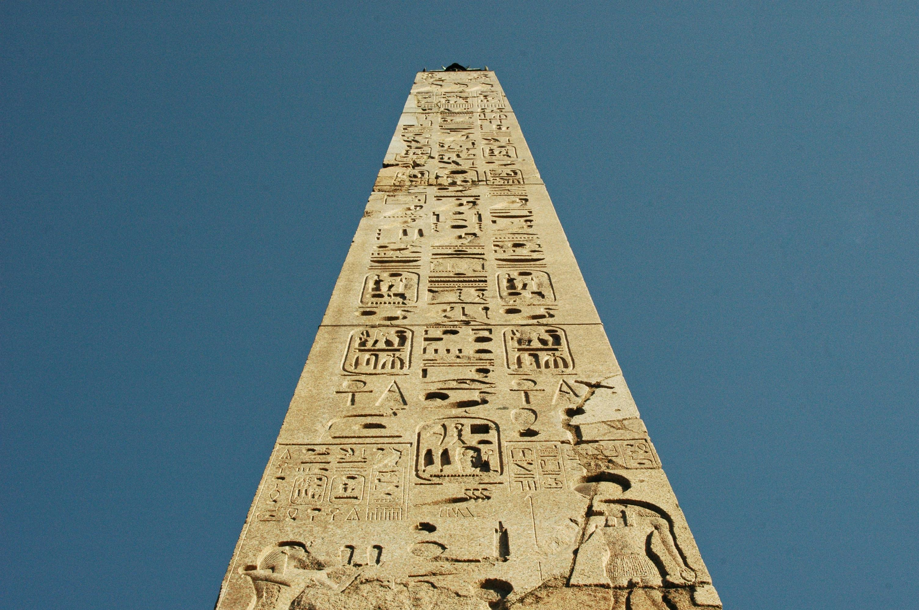
Problem Statement

Slide 5
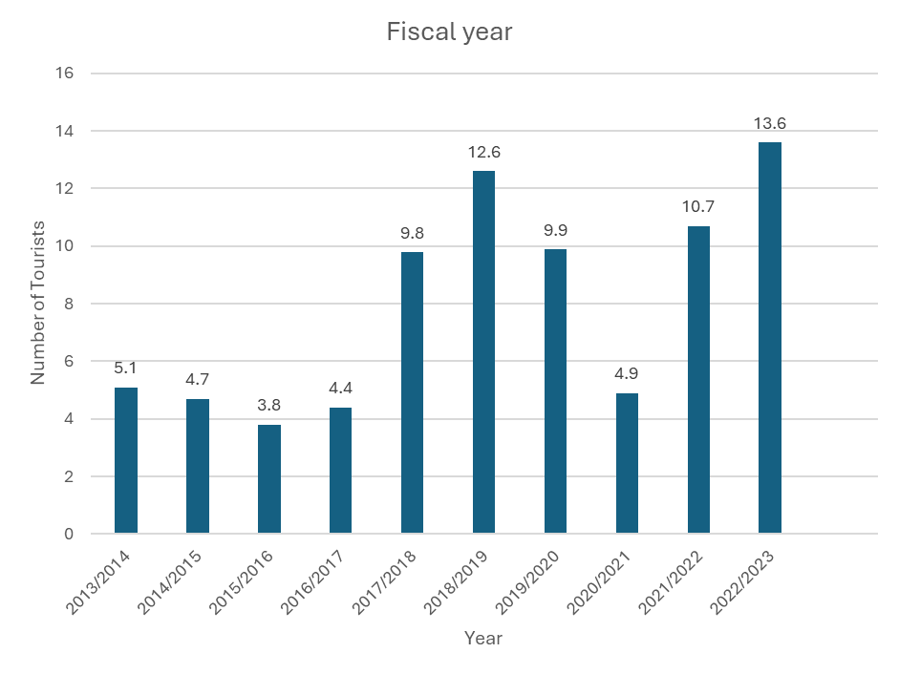
These are some official statistics issued by the Central Agency for Public Mobilization & Statistics(CAPMAS)
2023 witnessed the highest rate of incoming tourist traffic in the history of tourism in Egypt, achieving a record number of incoming tourists, which reached 15 million tourists. It is the highest rate of movement in the history of tourism in Egypt, as 2010, which was the peak year, achieved 14.7 million tourists.
The total number of tourists arriving to Egypt during the first half of this year reached 7.1 million

Slide 6
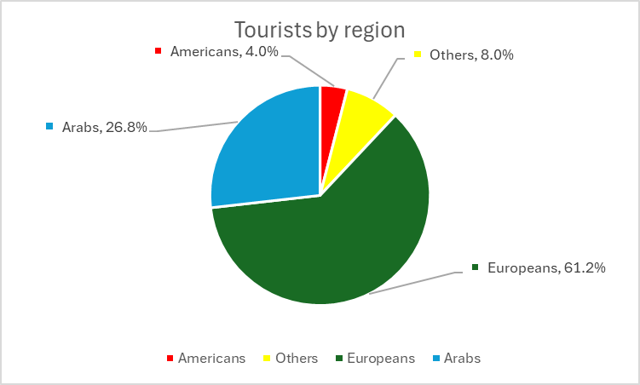
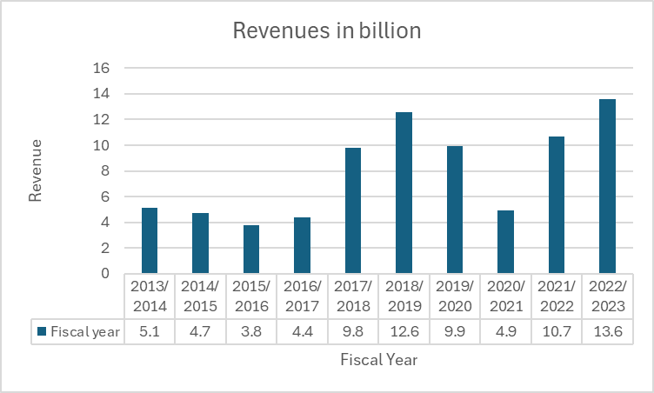
Egypt achieved revenues worth $6.6 billion from the tourism sector during the first half of this year, an increase of about 5% over the same period of the previous year. According to a statement by the Ministry of Tourism and Antiquities.
The tourism sector contributes about 11.3% of the GDB, provides about 13% of the total foreign exchange, and employs about 12.6% of the total Egyptian labor market force.

Slide 7
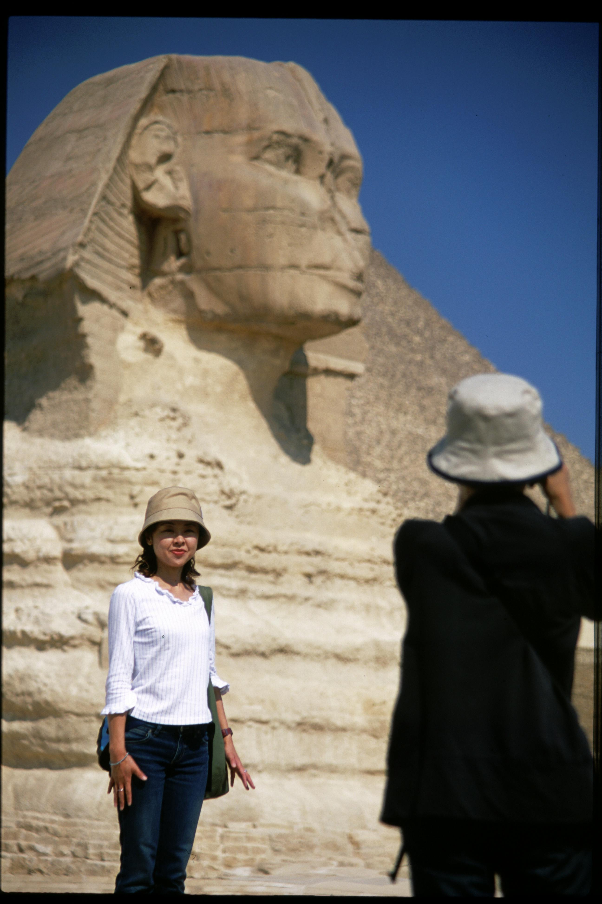
Project Objective

Slide 8
01
Develop a comprehensive decision-support system for new tourism businesses.
02
Empower businesses to make informed decisions based on UI.
03
Using AI Prediction model to predict the demand for tour packages
In different seasons over year
Our Project Aim To
04
Foster sustainability in the dynamic tourism industry landscape.
05
To lead us to improve our Local Economy because The local economy of the destination where tourism businesses operate can benefit significantly.

Slide 9
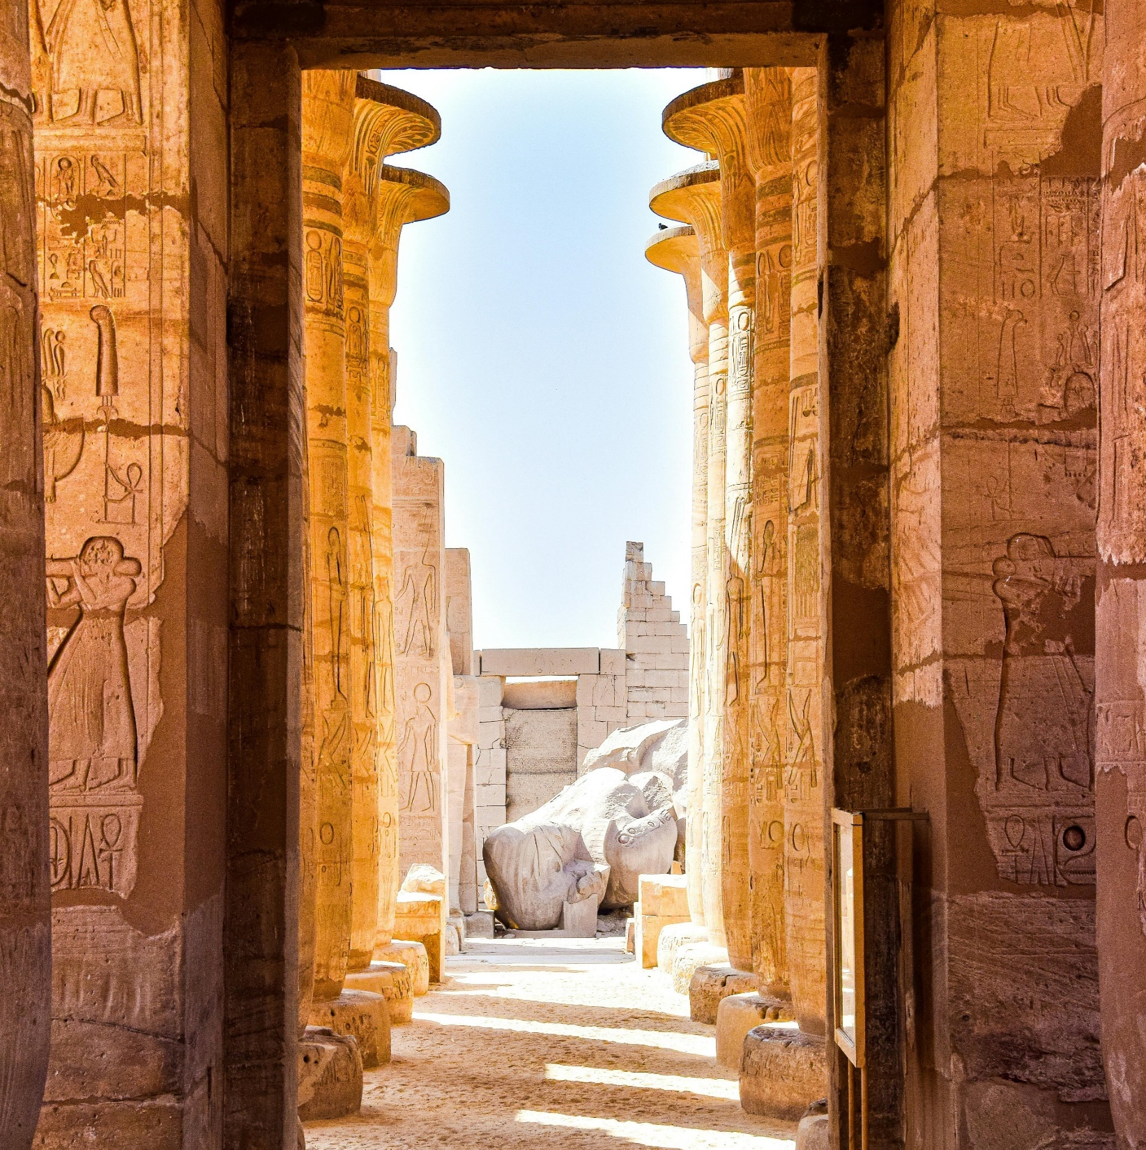
Mathematical Model Development

Slide 10





Initial Model Creation:
Developed a preliminary mathematical model to optimize strategic decision-making for new tourism businesses.
Model Refinement and Finalization:
Updates to the Mathematical Model
Addition of Parameters
Modification of Decision Variables
Enhancement of Constraints

Slide 11

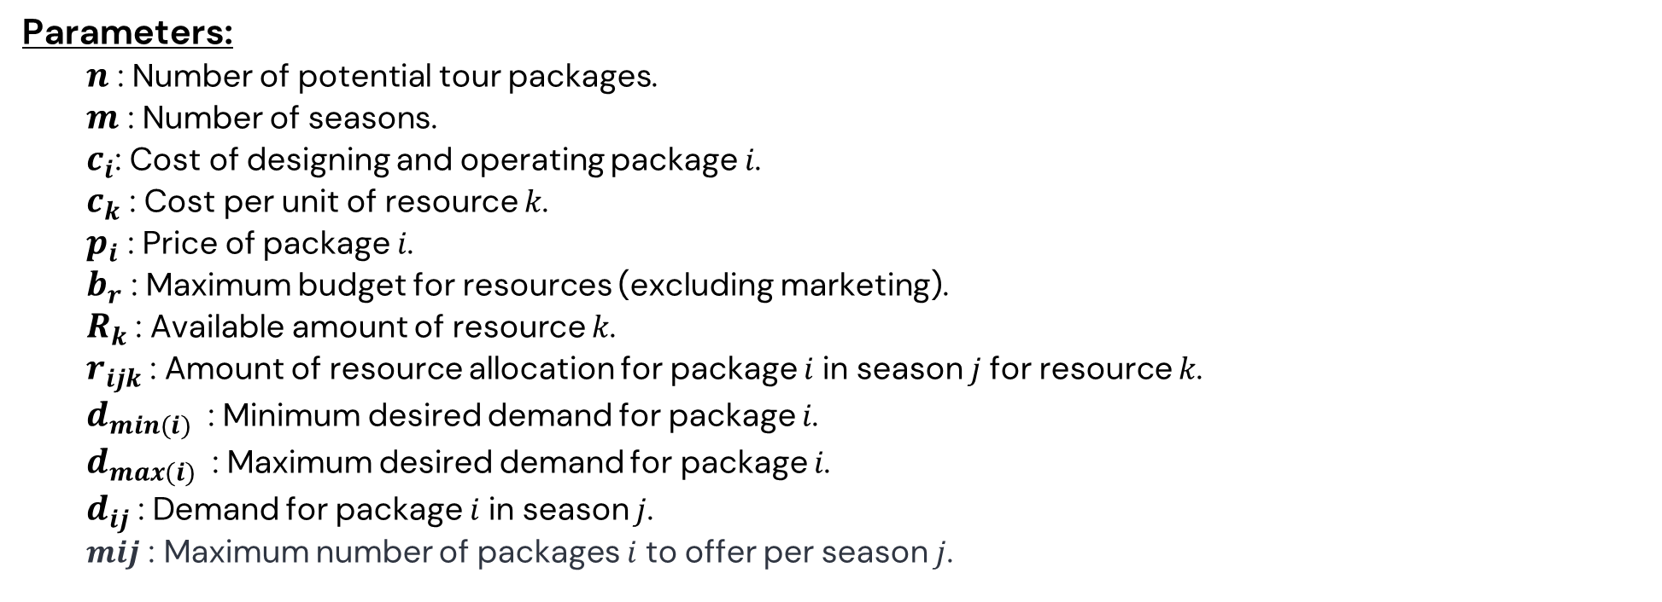
Final Mathematical Model:
Decision Variables:
${ x}_{ij}$ : Binary variable indicating whether to offer package 𝑖 in season 𝑗 (1 if offered, 0 otherwise).
Parameters:
$n$ : Number of potential tour packages. $m$ : Number of seasons. $c_{i}$: Cost of designing and operating package 𝑖. $c_{k}$​ : Cost per unit of resource 𝑘. $p_{i}$​ : Price of package 𝑖. $b_{r}$​ : Maximum budget for resources (excluding marketing). $R_{k}​$: Available amount of resource 𝑘. $r_{ijk}​$: Amount of resource allocation for package 𝑖 in season 𝑗 for resource 𝑘. $d_{min(i)}​$​ : Minimum desired demand for package 𝑖. $d_{max(i)}​$​ : Maximum desired demand for package 𝑖. $d_{ij}$​ : Demand for package 𝑖 in season 𝑗.
𝒎𝒊𝒋 : Maximum number of packages 𝑖 to offer per season 𝑗.

Slide 12

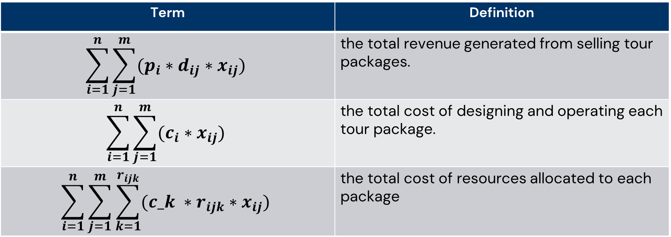
Objective Function :
$$Maximize Z=\sum_{i=1}^{n}{\sum_{j=1}^{m}{(p_{i}∗d_{ij}∗x_{ij})}}−\sum_{i=1}^{n}{\sum_{j=1}^{m}{(c_{i}∗x_{ij})}}−\sum_{i=1}^{n}{\sum_{j=1}^{m}{\sum_{k=1}^{r_{ijk}}{(c_k ∗r_{ijk}∗x_{ij})}}}$$
Term | Definition
$$\sum_{i=1}^{n}{\sum_{j=1}^{m}{(p_{i}∗d_{ij}∗x_{ij})}}$$ | the total revenue generated from selling tour packages.
$$\sum_{i=1}^{n}{\sum_{j=1}^{m}{(c_{i}∗x_{ij})}}$$ | the total cost of designing and operating each tour package.
$$\sum_{i=1}^{n}{\sum_{j=1}^{m}{\sum_{k=1}^{r_{ijk}}{(c_k ∗r_{ijk}∗x_{ij})}}}$$ | the total cost of resources allocated to each package

Slide 13

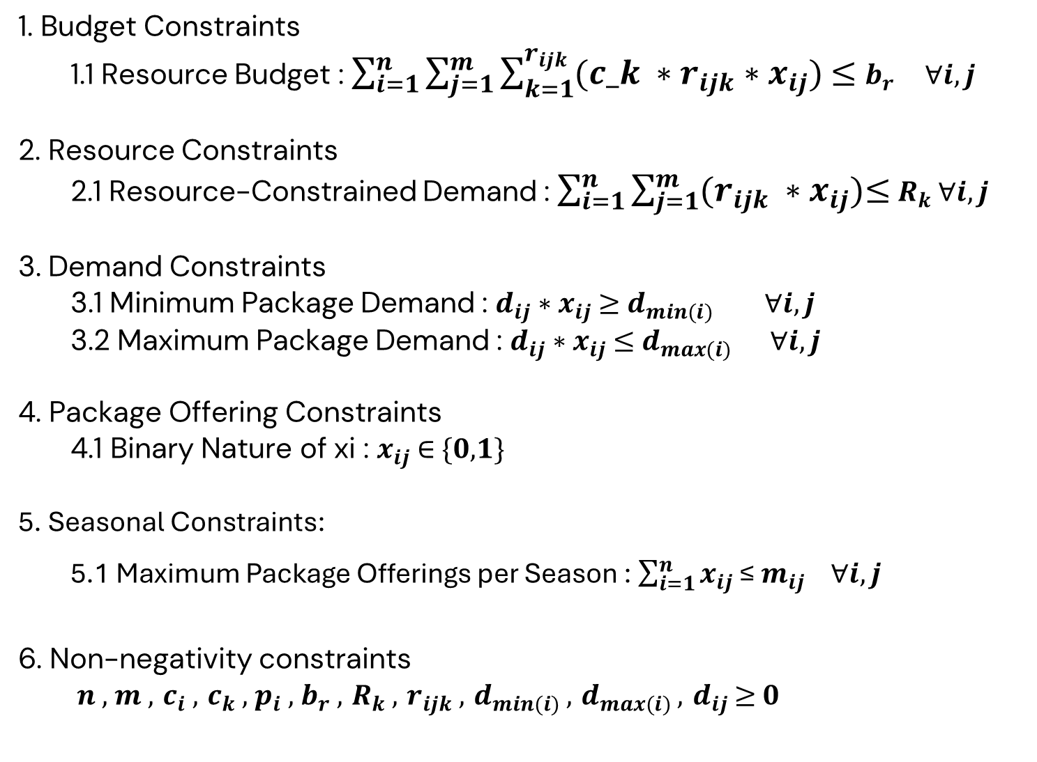
1. Budget Constraints 1.1 Resource Budget : $\sum_{i=1}^{n}{\sum_{j=1}^{m}{\sum_{k=1}^{r_{ijk}}{(c_k ∗r_{ijk}∗x_{ij})}}}$ ≤ $b_{r }$ $∀i,j$
2. Resource Constraints
2.1 Resource-Constrained Demand : $\sum_{i=1}^{n}{\sum_{j=1}^{m}{(r_{ijk} ∗x_{ij})}}$≤ $R_{k}$ $∀i,j$
3. Demand Constraints 3.1 Minimum Package Demand : $d_{ij}$∗ $x_{ij}$ ≥ $d_{min(i)}​$ $∀i,j$
3.2 Maximum Package Demand : $d_{ij}$∗ $x_{ij}$ ≤ $d_{max(i)}$ $∀i,j$
4. Package Offering Constraints
4.1 Binary Nature of xi : $x_{ij}$ ∈ {𝟎,𝟏}
5. Seasonal Constraints:
5.1 Maximum Package Offerings per Season : $\sum_{i=1}^{n}{x_{ij}}$≤ $m_{ij} ∀i,j$
6. Non-negativity constraints 𝒏 , 𝒎 , $c_{i}$ , $c_{k}$ , $p_{i}$, $b_{r}$ , $R_{k}$ , $r_{ijk}$ , $d_{min(i)}$ , $d_{max(i)}$ , $d_{ij}$ ≥ 𝟎
Constraints:

Slide 14
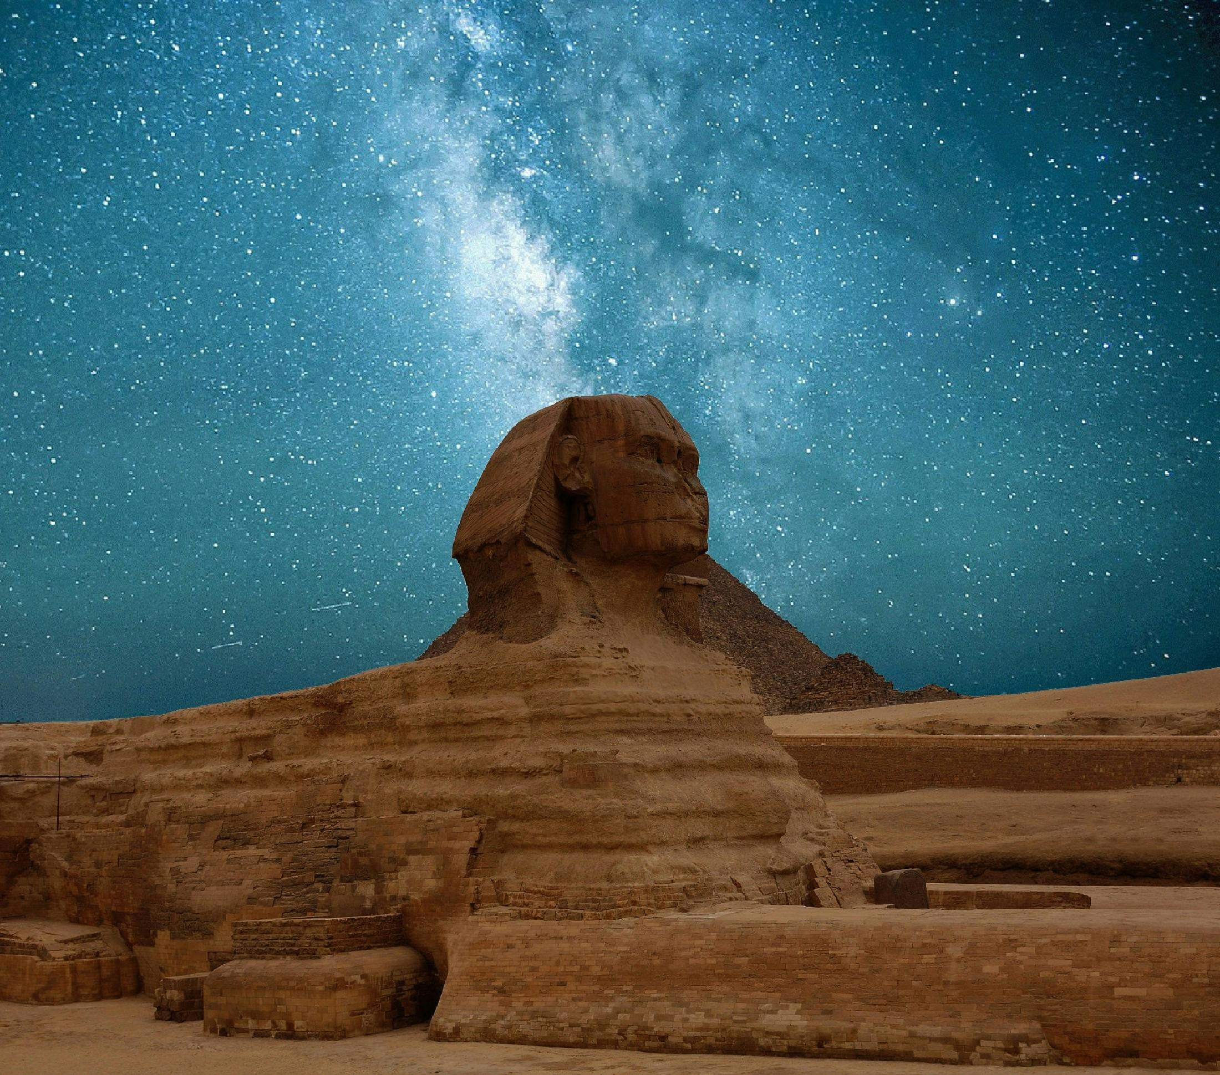
Data Collection & Preprocessing

Slide 15


Data Collection
Data Collection Sources : Most of the data was collected from Egypt Tours Portal Company and it depends on industry reports and market research surveys, providing information on tour package costs, resource availability, demand patterns, and pricing structures.
Challenges: Due to confidentiality, some critical data points were not shared by the companies.
Solution: Hypothetical data was created to simulate essential variables and combined with real-world data which we got.

Slide 16

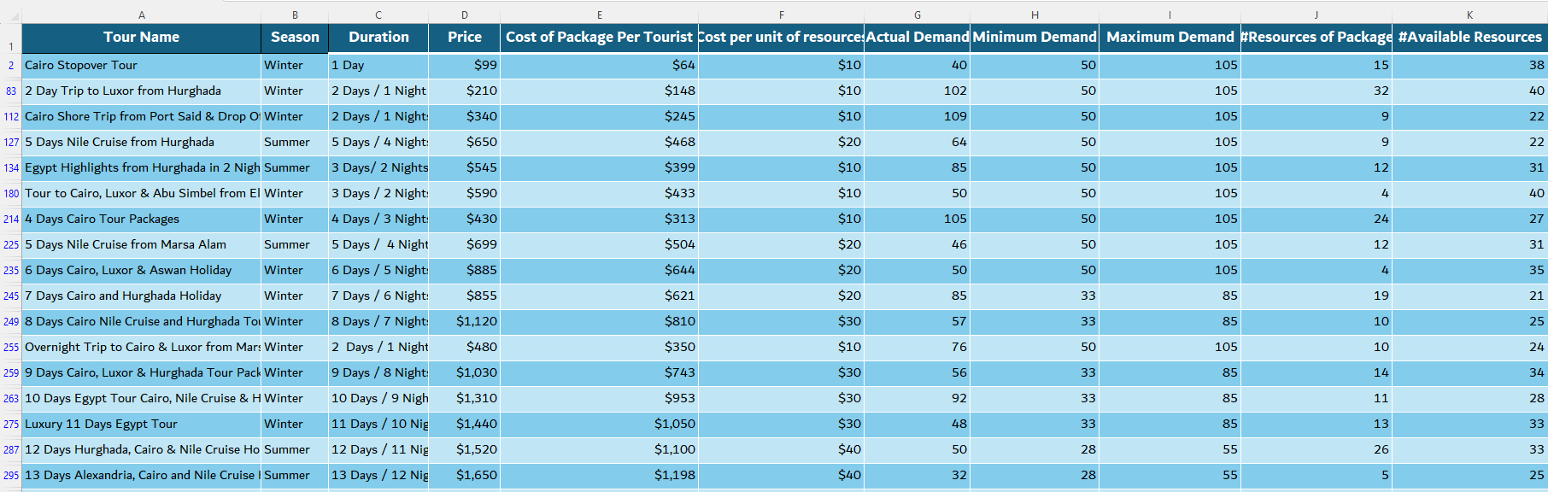
Identifying Relevant Data and Verifying:

Slide 17

Data Preprocessing & Transformation:
Data Correction: Inaccuracies and errors in the data were corrected by cross-referencing with reliable sources and expert validation.
Data Cleaning: Irrelevant data was removed to streamline the dataset, focusing only on relevant information.
Data Integration: Real-world and hypothetical data were seamlessly integrated, ensuring comprehensive analysis with all relevant variables.
Data Normalization: Numerical data was normalized to a common scale for easier comparison and analysis of variables to fit the model

Slide 18

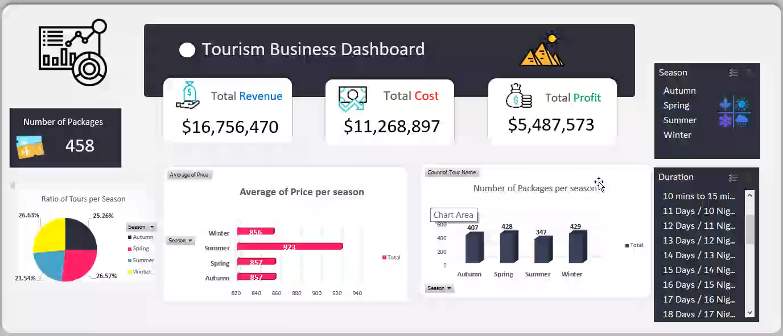
Data Analysis:
Identify Relationships
Generate Hypotheses
Descriptive Statistics
Plots

Slide 19
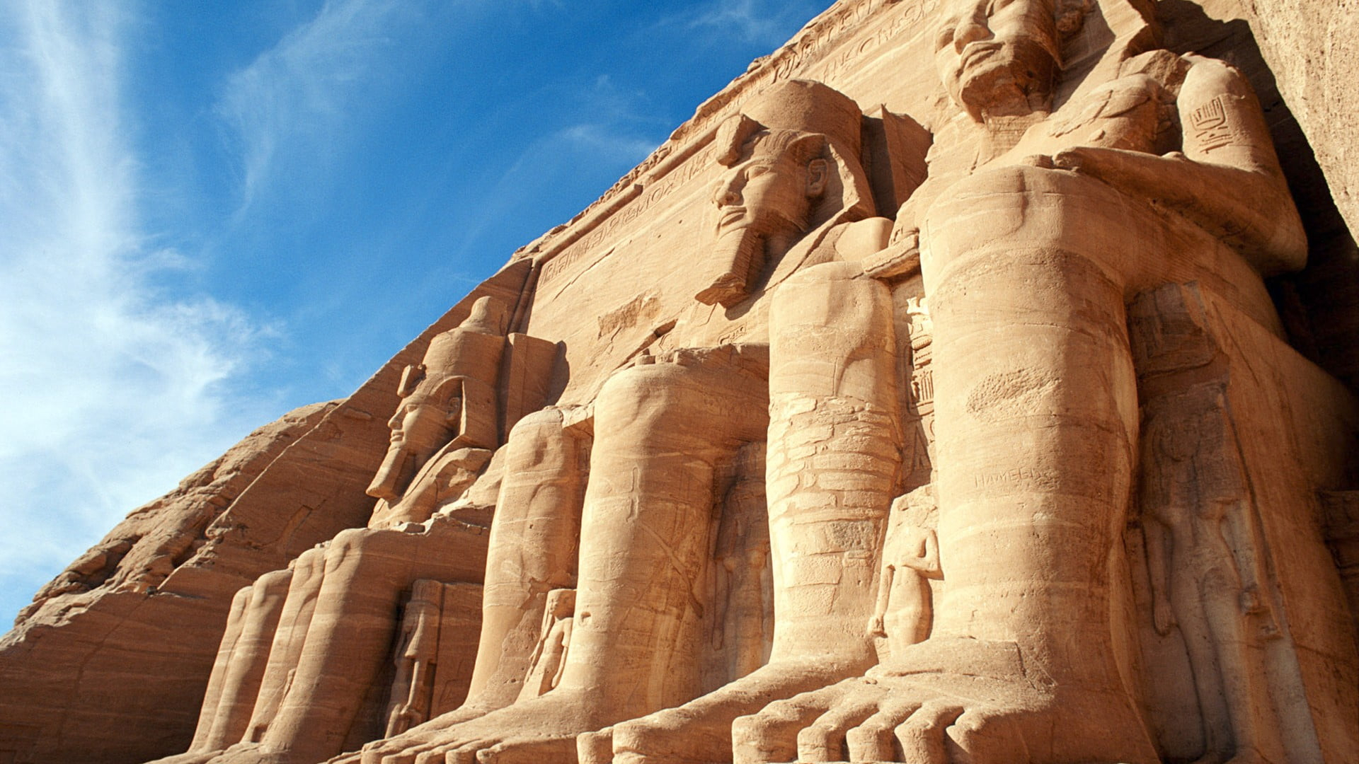
Implementation

Slide 20

The Differences Between Solutions(Exact-Metaheuristic):
Exact Solution:
Definition : method finds the optimal solution to a problem with a guarantee of accuracy. These methods explore all possible solutions to ensure the best one is found.
Common Techniques:
Integer Programming (IP)
Mixed-Integer Linear Programming (MILP)
Linear Programming (LP)
Dynamic Programming (DP)
Metaheuristic Solution:
Definition: high-level problem-independent algorithmic frameworks that provide near-optimal solutions by exploring the solution space more efficiently.
Common Techniques:
Genetic Algorithms (GA)
Ant Colony Optimization (ACO)

Slide 21
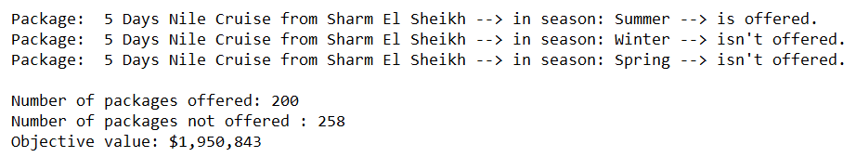
Applying Exact Solution to Solve the Model
Exact Solution Approach using Mixed-Integer Linear Programming (MILP)
Our model is Mixed-Integer Linear Programming (MILP) model.
Tools Used: Python and PuLP library.
Sample from Output of solution:

Slide 22
Applying Metaheuristic Solutions to Solve the Model
Optimization Using Genetic Algorithm and Ant Colony Optimization
Genetic Algorithm (GA)
Population-based search algorithm.
Uses selection, crossover, and mutation operators.
Sample from Output of Genetic Algorithm:
Best Fitness Value Achieved: $602,950
Time Taken for Convergence (seconds): 0.84
Ant Colony Optimization (ACO)
Simulates the pheromone trail-laying and following behavior of ants.
Sample from Output of Ant Colony Optimization:
Best Fitness Value Achieved: $564,800
Time Taken for Convergence (seconds): 13.72

Slide 23

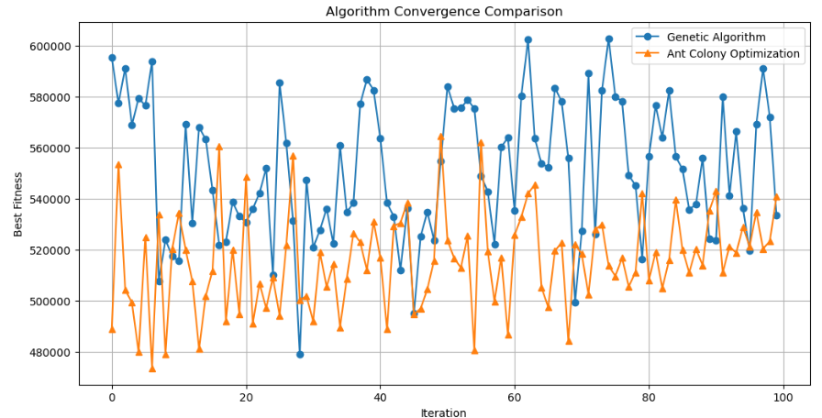
Applying Metaheuristic Solutions to Solve the Model - (Continued)
Comparison Between Two Algorithms

Slide 24

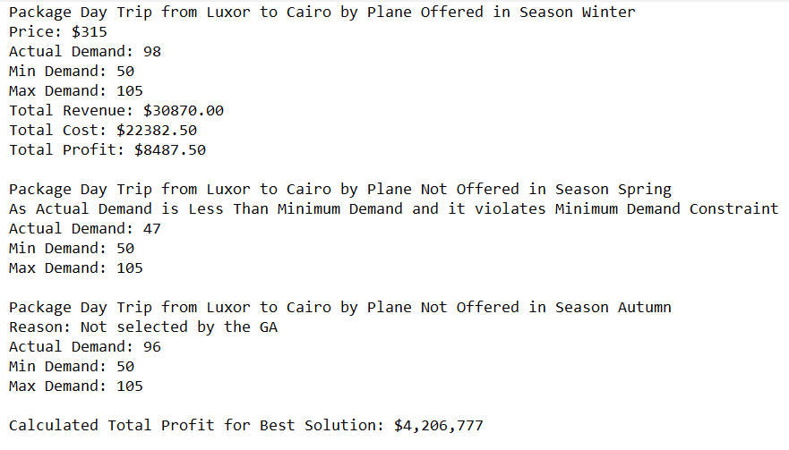
Optimizing Tour Packages Using Genetic Algorithm:
Aim: Optimize tour packages across different seasons to maximize profitability and manage resources efficiently.
Chosen Algorithm: Genetic Algorithm (GA) for its superior performance in achieving high fitness values , powerful approach due to its ability to handle complex, multi-dimensional optimization problems
Output of Genetic Algorithm:

Slide 25
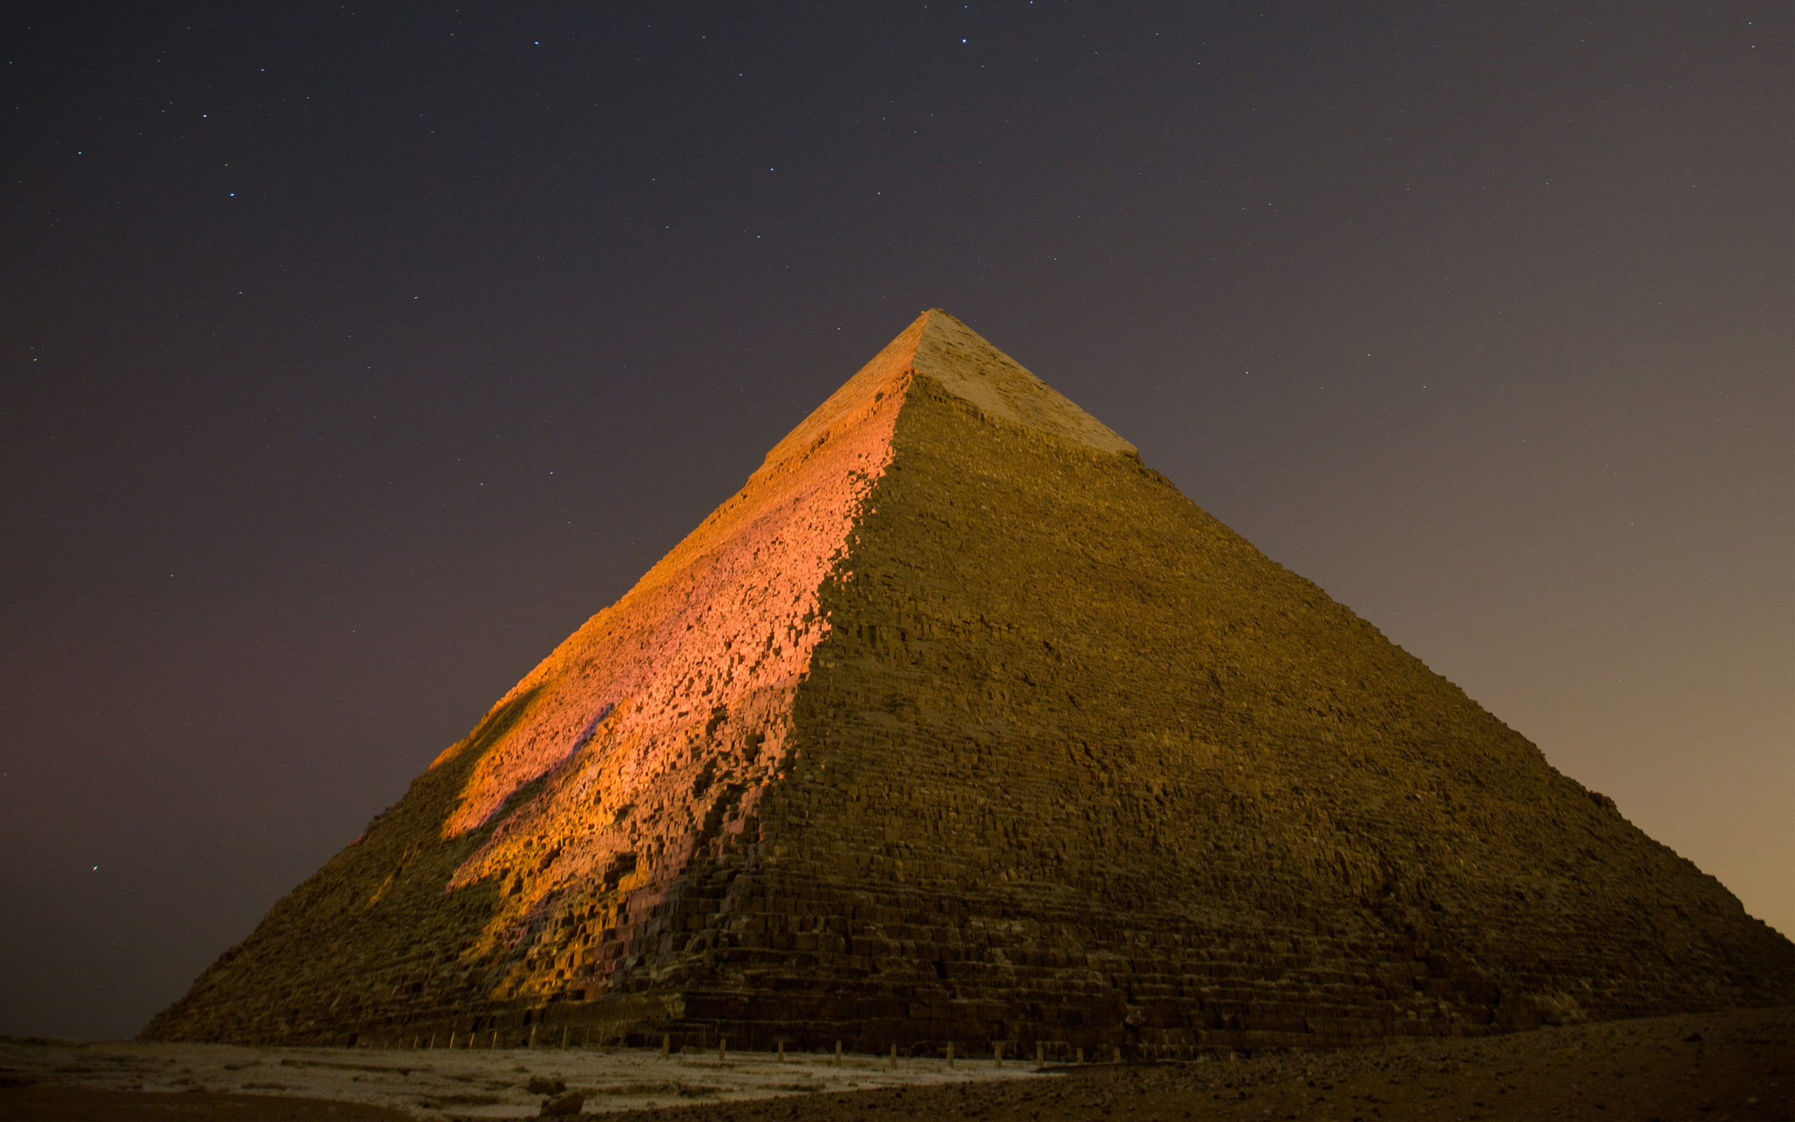
User Interface (UI)
Development

Slide 26







Purpose: Facilitate easy interaction with data for tourism industry professionals.
Technology: Developed using C# and .NET Framework as a Windows Form application.
Tools: SQL Server Management Studio(SSMS) 2019 , Microsoft Visual Studio 2022
Key Features of the UI
User-Friendly Interface: Allows administrators to manage tourism packages, prices, resources, and budgets.
Role-Based Access Control: Ensures secure and appropriate access for different admin roles.
Real-Time Data Updates: Provides immediate reflection of changes made to data.
Data Validation: Ensures accuracy and consistency of data entered by users.
Error Handling and Notifications: Informs users of errors and successful operations through pop-up notifications.
Search and Filter Options: Enables efficient navigation and management of large datasets.

Slide 27

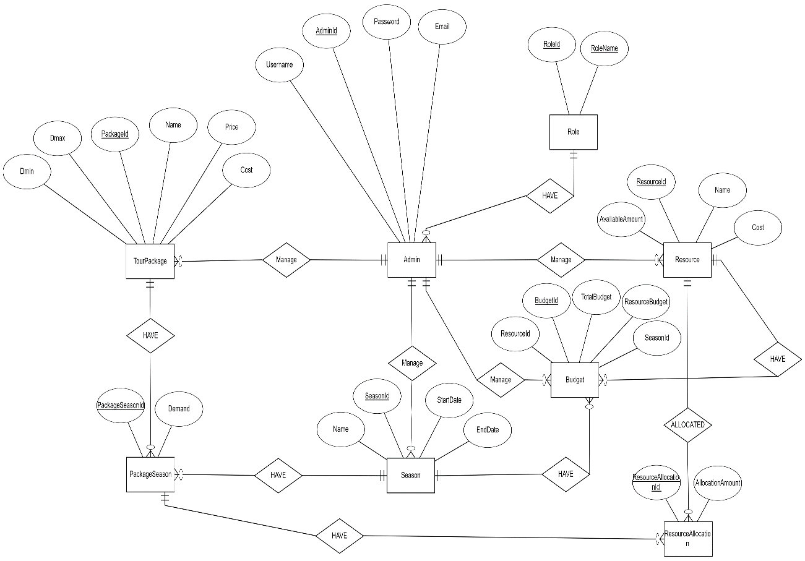
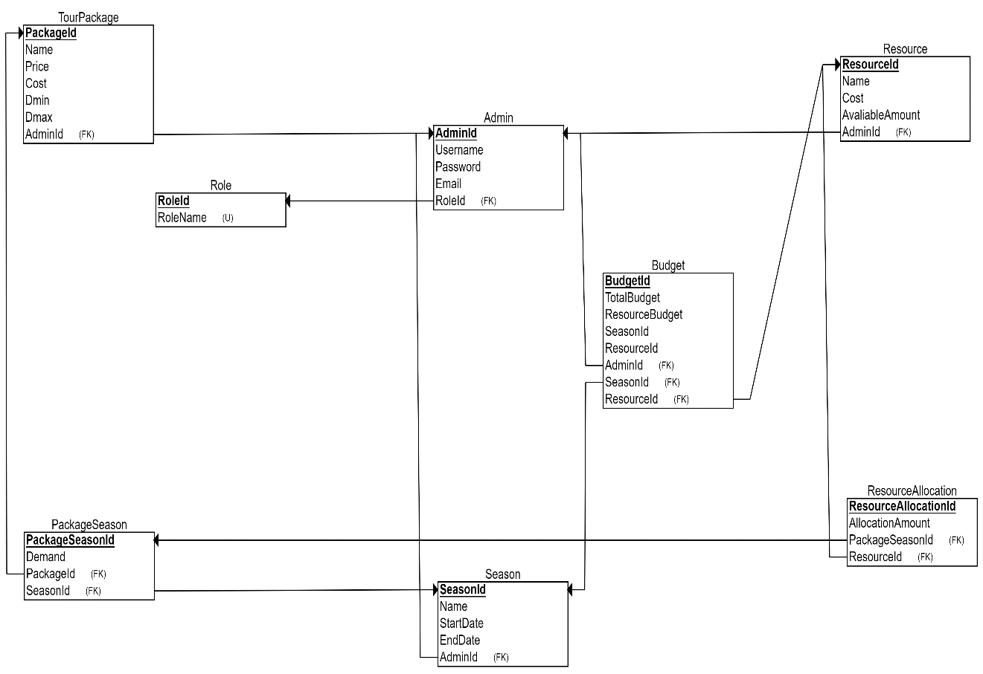

Database Design:
ER Schema and ER Diagram: Developed an Entity-Relationship schema and diagram to outline the database structure.

Slide 28

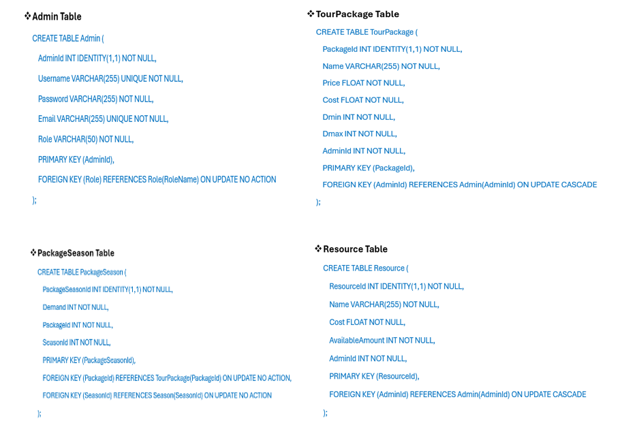
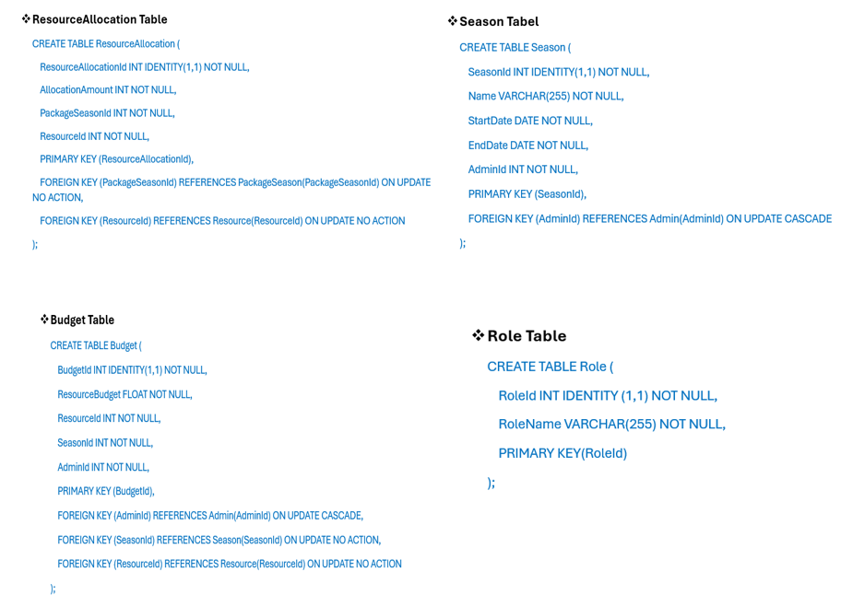
Database Tables:

Slide 29

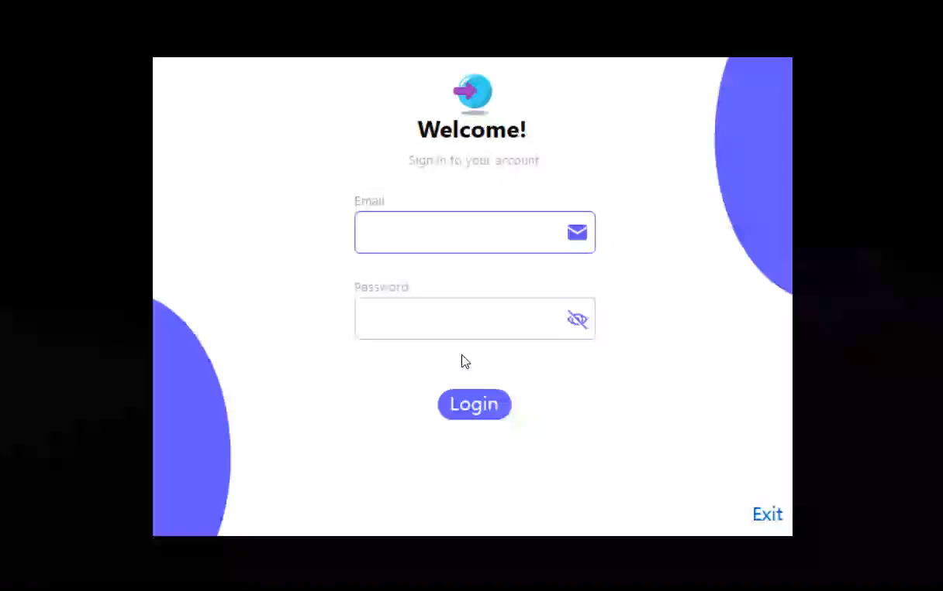
Windows Form Application:
Login Page: Ensures secure access with email and password authentication. Role-based access control is implemented.
There is a comparison between Super Admin and Finance Admin of what they can access

Slide 30

Admin Dashboard Page: Varies based on admin's role.
There is a Scenario of what Super Admin can do

Slide 31
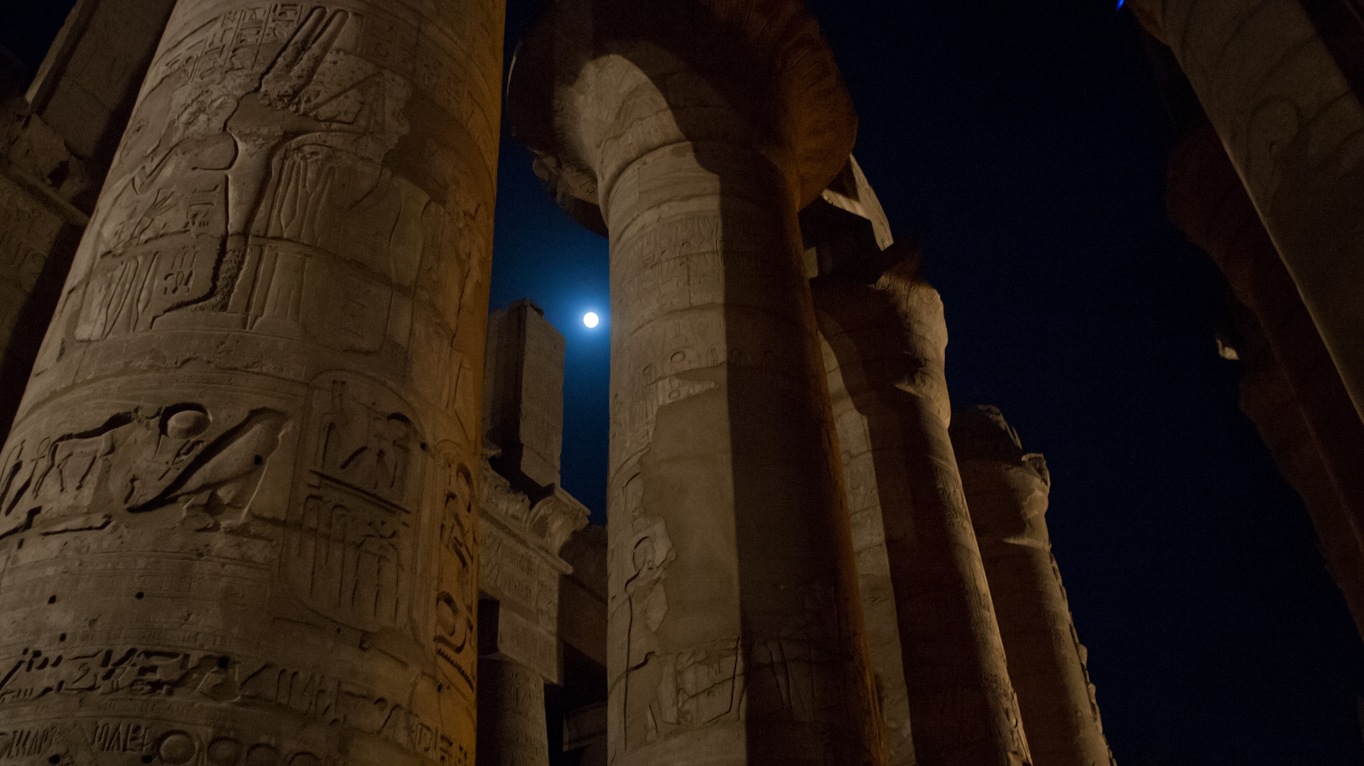
AI Prediction Model Development

Slide 32

Overview of AI Techniques in Demand Prediction:
1. Gradient Boosting Regressor
Sequentially builds trees to correct errors.
Combines weak models to form a strong predictor.
Excellent for minimizing bias and variance.
5. SVR
Uses support vectors to define the best fit line.
Effective in high-dimensional spaces.
Robust against outliers.
1
2. Random Forest
5
Ensemble method using multiple decision trees.
Reduces overfitting by averaging results.
Highly accurate and robust.
6. Linear Regression
2
3
6
Predicts a dependent variable using a linear equation.
Fits a line to minimize the distance to data points.
Easy to interpret and implement.
4
7
3. Decision Tree
Uses a tree-like model of decisions.
Splits data into branches based on feature values.
Simple to visualize and understand.
7. KNN
Predicts based on the nearest data points.
Simple and intuitive algorithm.
Effective for small datasets with clear patterns.
4. Neural Network
Mimics the human brain with layers of neurons.
Capable of capturing complex patterns.
Powerful for large datasets.

Slide 33

Methodology:
Data Merging
Feature Selection
Standardization
Splitting the Data
Data Availability

Slide 34
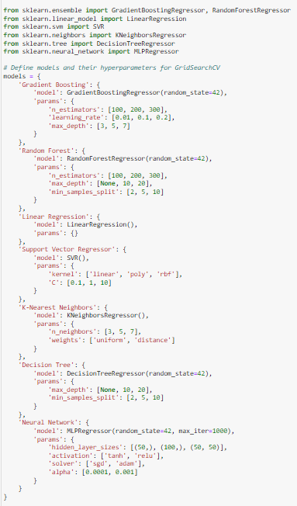
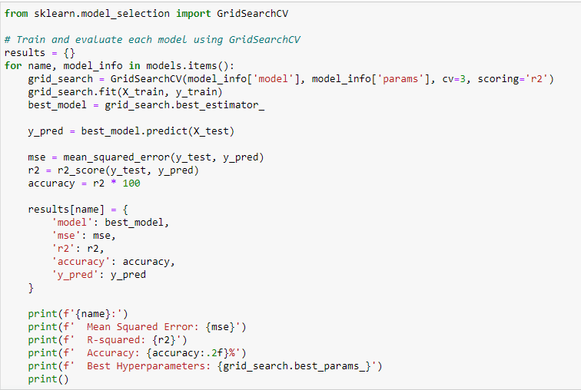
Model Training and Evaluation – (Continued)
Selection of ML Models and Test Hyperparameter
Hyperparameter Tuning Parameters

Slide 35
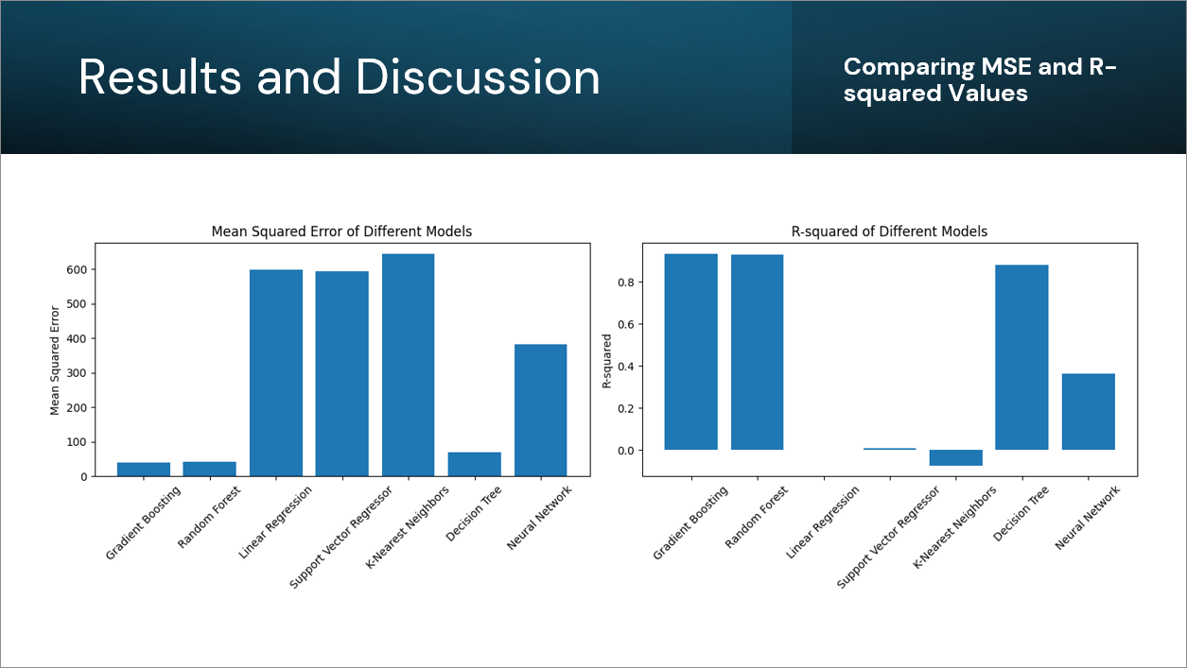

Slide 36
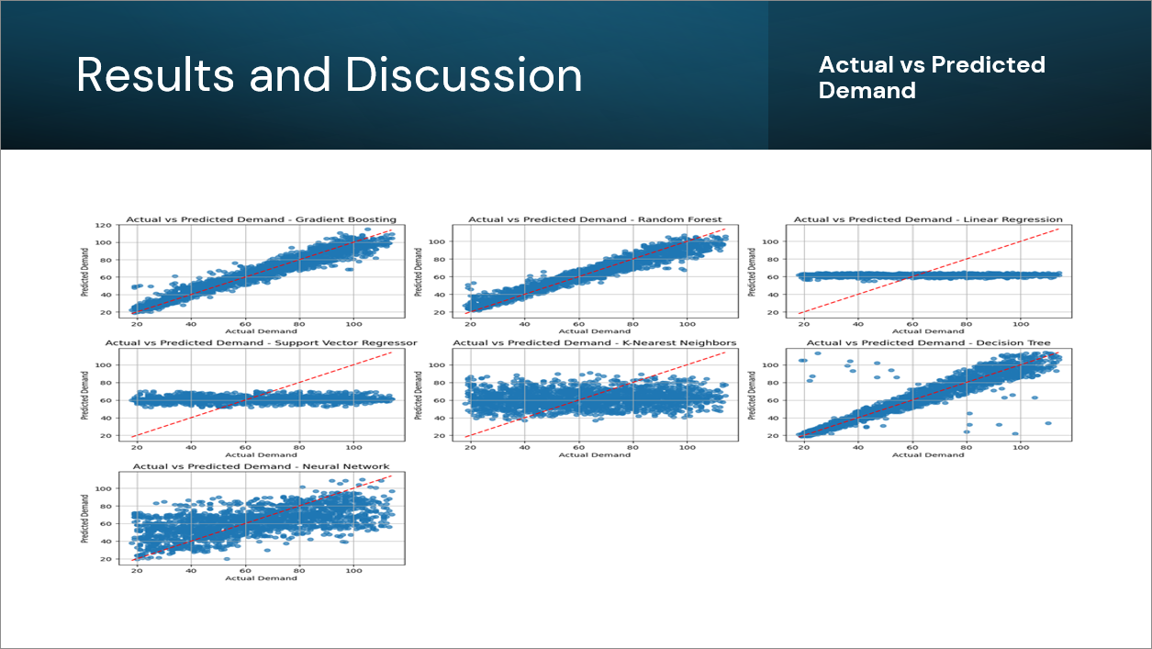

Slide 37

Results and Discussion
Model Performance
Gradient Boosting Regressor
Accuracy: 93.46%
Random Forest
Accuracy: 93.02%
KNN
Accuracy: -7.42%
Decision Tree
Accuracy: 88.23%
Linear Regression
Accuracy: 0.24%
Neural Network
Accuracy: 36.19%
SVR
Accuracy: 0.81%

Slide 38




Graphical User Interface (GUI) Development
Easy Demand Forecasting!
New user-friendly tool predicts demand!
Simply enter information and get results.
See clear charts to understand the data.
Built with Python (Tkinter) for smooth operation.

Slide 39

Graphical User Interface (GUI) Development
Test Scenario:

Slide 40
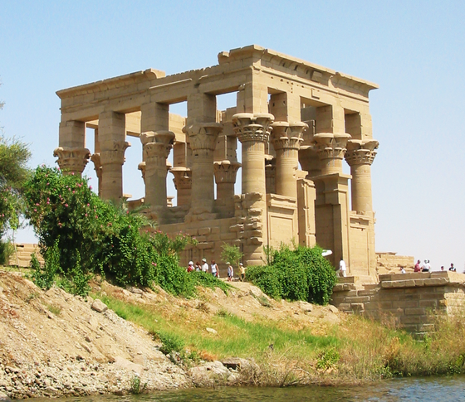
Conclusion

Slide 41
1
Developed a mathematical model to predict and optimize various aspects of tourism demand.
2
Collected extensive data relevant to the tourism industry , Performed thorough data analysis to identify patterns and trends that informed the prediction model.
3
Developed a user-friendly interface using C# and the .NET Framework that Facilitates management of tourism resources, packages, and budgets , Enables operators to make informed decisions based on data insights.
4
Built an AI prediction model using Python and Tkinter.
Ai Model Forecasts tourism demand accurately based on features like season and price , optimizes resource allocation, reduces waste, and improves efficiency in tourism management.
5

Slide 42

Key Outcomes:
1
Created a robust system that enhances the efficiency and effectiveness of tourism management.
2
The AI prediction model's ability to forecast demand accurately aids in better resource allocation.
By integrating these components, we have developed a comprehensive solution for optimizing the tourism industry, ensuring informed decision-making and efficient management.

Slide 43

Thank you
DO YOU HAVE ANY QUESTIONS?

